Slide 1
Machine Learning: Text Mining “Feature Extraction”
CS5543: Tutorial 12

Slide 2
Workflow: Text Classification
Training (Learning)
tokenizeAndStem
tfidfTransformerTest
createLabeledDocument
Tokenizing and Stemming
TF-IDF
Naïve Bayes Model Creation
Training
Input Data
Testing
Tokenizing and Stemming
TF-IDF
Classifying the test data
Label
createLabeledDocumentTest
tokenizeAndStem
tfidfTransformer
Testing (Recognition)

Slide 3
Steps
Preprocessing – NLP
Feature Extraction – TF-IDF (ranking terms)

Slide 4
Preprocessing : NLP
Stanford Core NLP : http://nlp.stanford.edu/software/corenlp.shtml
Two main NLP techniques
Tokenization
Stemming

Slide 5
Preprocessing - Dependencies
"edu.stanford.nlp" % "stanford-corenlp" % "3.5.2", "edu.stanford.nlp" % "stanford-corenlp" % "3.5.2" classifier "models"

Slide 6
Tokenization
A tokenizer divides text into a sequence of tokens or a group of sentences.
It ignores punctuations
http://nlp.stanford.edu/software/tokenizer.shtml

Slide 7
Tokenization : Implementation
Check edu.umkc.preprocessing.text.Tokenizing.java in the tutorial package for the implementation
Details
toSentences : This uses DocumentPreprocessor from CoreNLP to tokenize paragraph into sentences
toTokens : This uses PTBTokenizer (Core NLP implementation of Penn Treebank tokenization) to tokenize sentences into words

Slide 8
Stemming
the process for reducing inflected (or sometimes derived) words to their word stem, base or root form
For example :
Reducing → Reduce
Inflected → Inflect

Slide 9
Lemmatization
Stemming usually refers to a crude heuristic process that chops off the ends of words in the hope of achieving this goal correctly most of the time, and often includes the removal of derivational affixes.
Lemmatization usually refers to doing things properly with the use of a vocabulary and morphological analysis of words, normally aiming to remove inflectional endings only and to return the base or dictionary form of a word, which is known as the lemma .
Example : Stemming : saw → s
Lemmatization: saw (verb) → see
saw (noun) →saw
Source : http://nlp.stanford.edu/IR-book/html/htmledition/stemming-and-lemmatization-1.html

Slide 10
Lemmatization : Implementation
Check edu.umkc.preprocessing.text.Tokenizing.java in the tutorial package for the implementation
Details
We use pipeline approach similar to Sentiment Analysis discussed in previous tutorials
We use “tokenize, ssplit, pos, lemma” in the pipeline. Our last step is lemma, since lemma is dependent on the data retrieved from previous steps
Tokenize -> Tokenization into tokens
Ssplit -> aggregates a sequence of tokens into sentences
POS -> Parts of speech for the tokens
Lemma -> Lemmatization

Slide 11
Feature Extraction
TF-IDF (ranking terms)

Slide 12
TF-IDF (Ranking Terms)
tf–idf, short for term frequency–inverse document frequency, is a numerical statistic that is intended to reflect how important a word is to a document in a collection or corpus.
We will implementing in two different ways
Spark MLlib (http://spark.apache.org/docs/latest/mllib-guide.html)
Weka (http://www.cs.waikato.ac.nz/ml/weka/)

Slide 13
TF-IDF (Spark MLlib)- Dependencies
"org.apache.spark" %% "spark-core" % "1.5.0" % "provided", "org.apache.spark" %% "spark-mllib" % "1.5.0",

Slide 14
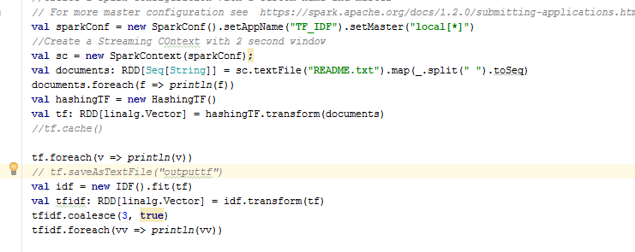
TF-IDF (Spark – MLlib) : Implementation
For implementing in Spark MLlib; we use HashingTF and IDF classes

